Slide 1
Extreme Domino HTTP Configuration
Andrew Pollack, President
Northern Collaborative Technologies
andrewp@thenorth.com
http://www.thenorth.com

Slide 2
Who Am I?
Administrator & Developer since version 2.0
IBM Lotus Beacon Award Winner
Services
Site Performance Reviews
Legal Case Consulting
Application Development
Administrative Overhaul
Security Review & Penetration Testing
Products
NCT Search
NCT Compliance Search
NCT Simple Sign On
Structural Firefighter

Slide 3
Agenda
The Server Document
Web Site Documents
Authentication Credential Choices
Authentication with SAML
Web Site Configuration Rules
SSL Certificate Configuration
Memory & Performance Tuning
A few Security Tips
Tips for Debugging HTTP
Questions

Slide 4
The Server Document
Where it all starts…

Slide 5
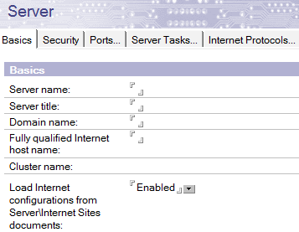
Please Use the Internet Sites View
Most of the advanced features require this setting
If your server is really old you may need to re-save for this setting to be active

Slide 6
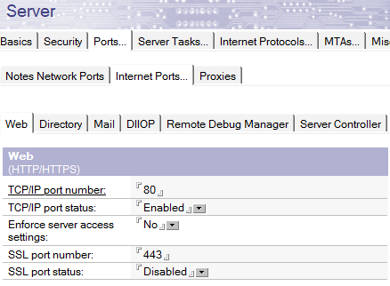
Make Sure to Enable the Ports
By Default the HTTP port is enabled by the HTTPS port is not
This is the most common configuration headache for first time administrators setting up SSL

Slide 7
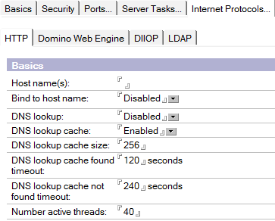
Server Wide HTTP Settings - Basics
Host Name is used by the server when generating references
DNS Lookups only need to be on if you are logging and want the DNS name of the requesting clients
The Number of Active Threads is critical for performance tuning!
We will visit this setting at length

Slide 8
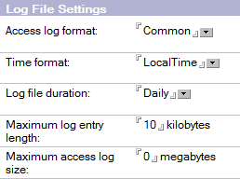
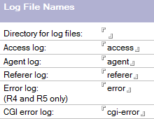
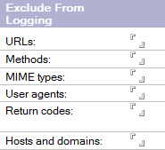
Server Wide HTTP Settings – Logging
DOMLOG seems convenient but gets very
Big very fast – Use sparingly or not at all
Use Standardized log files
Can be compatible with analysis tools
Write to an alternate drive if possible
Make sure to remove/rotate them by age

Slide 9
Server Wide HTTP Settings – Network
These settings will generally not help you as much as you think
Use the IP Address allow/deny list when using a cluster sprayer or reverse proxy to prevent direct connections from browsers
The IP address deny list is helpful to block attacks briefly
Most attacking sites will quickly adapt use many addresses

Slide 10
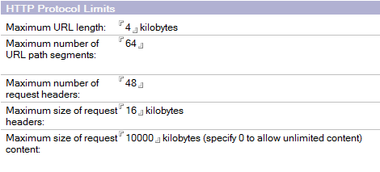
Server Wide HTTP Settings - Limits
URL Length may be too small if you are developing sites with AJAX style requests
Maximum size of Request may be too small if you are working with a web services that transfer a lot of data

Slide 11
Server Wide HTTP Settings – Web Engine Tab
Most of the settings can and should be left alone, with the exception of the following (we’ll talk performance later):
Run web agents concurrently
Enable this unless you have web agents that will write to the same documents when run, creating replication conflicts. You probably don’t have this problem.
Web Agent & Web Services Timeout
Don’t leave this at “0” (no timeout) or runaway agent code will steal a thread forever. Set it high if you have to, but set it to something
XML Services
If you’re not using Portal Server (or some Xpages functionality) turn it off to avoid possibly exposing data

Slide 12
The Internet Sites View
You want to use this – even If you have just one site

Slide 13
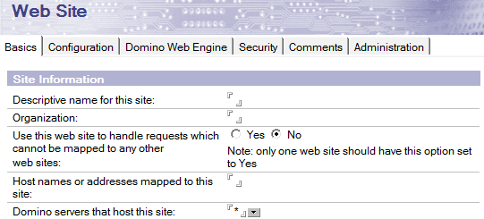
Web Site Documents

Slide 14
Web Site Document - Basics
Organization – should usually match your domain
Can be used to group web site documents with ltpa settings
Use this web site to handle default requests
It is better to have an explicit configuration for each site
Even if there is only one site
Host Name or IP Addresses Mapped to this site
This is how an incoming request is matched to a site configuration
Use IP address when possible – especially if you use SSL
Be specific about which
Domino Servers host a site

Slide 15
Web Site Document - Basics
If you want to have more than one site using SSL and they have different certificates you MUST bind the sites to the IP address and not the incoming domain name

Slide 16
Web Site Document - Configuration
Default Mapping Rules
These apply to serving files from the file system rather than Domino Databases.
DSAPI Filters
This is for custom API code that can manipulate almost anything about the http session. DSAPI code is notoriously hard to write well, and can easily crash a server. Avoid it if at all possible.
Allowed Methods
You should definitely disable the “TRACE” method
You can probably disable “PUT”, “Delete”, and “Patch” as well
Disable WebDAV

Slide 17
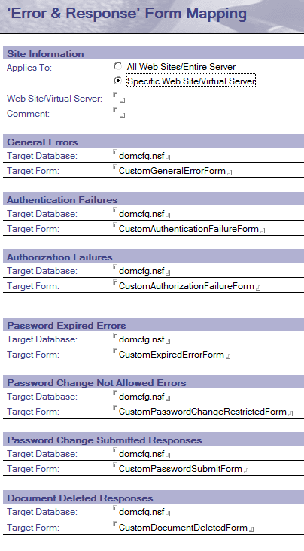
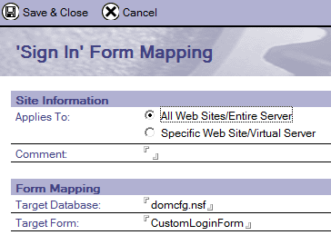
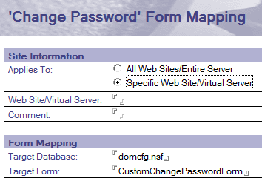
Custom Login & Error Screens
The DOMCFG.NSF Is used to configure custom login and error screens on a site by site basis

Slide 18
Session Authentication Choices
Disabled - Will use old school name and password dialog
Very poor security – credentials are included in every request
Realm issues lead to repeated password prompts
Single Server
Cookie based authentication token on the client side
Avoids realm based re-prompting
Domino will generate the token internally
If you re-start the http task all users must re-authenticate
Multiple Servers
Works like Single Server but uses a pre-defined LTPA Token
Restarting the HTTP task does not force re-authentication
Authentication credentials are shared across servers
SAML (New in Domino 9)
Requires extensive configuration & Planning

Slide 19
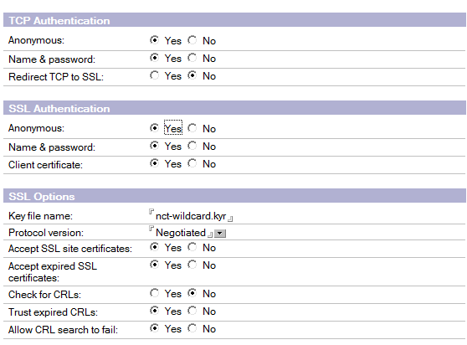
Web Site Configuration – Security Settings
Most of these are self explanatory
Do not turn on “Accept SSL site Certificates” unless you have issued client side ssl certificates to end users
You probably haven’t

Slide 20
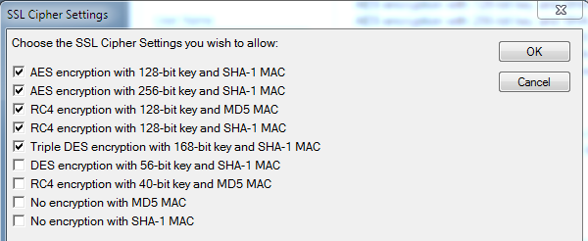
Web Site Configuration – SSL Ciphers
You can avoid getting calls from your security auditors by setting your SSL Ciphers as follows:
Disabling the 40 and 56 bit key will check a box on their testing forms and everyone can feel more secure

Slide 21
Authentication with SAML

Slide 22
SAML Terminology
Security Assertion Markup Language
IdP – Identity Provider
Oracle Identity Manager
IBM Tivoli Federated Identity Manager
Microsoft Active Directory Federation Services
SP – Service Provider
Your Domino Server
Assertion – What the IdP tells the SP

Slide 23
SAML Benefits/Use Cases
A single trusted, authoritative source is used to authenticate users who then need access to resources on multiple servers
often outside the control sphere of the authoritative source.
Allows third parties to provide services to a user community, while management of that community remains centralized.
Highly flexible security and meta data capabilities allow a wide range of interoperability
We’ll talk about “Assertions” in a minute

Slide 24
SAML in Domino 9
Domino acts as an SP only, not an IdP
Currently only supports two IdP Products
Microsoft Active Directory
Tivoli Federated Identity Manager
There are reports of it working with others
Most common IdP I’ve seen is Oracle Federated Identity
add on to Oracle Identity Manager
Requires a Notes ID and Person Document for all federated Notes Client users
but not necessarily browser access users
Requires the use of ID Vault if used for Notes Client federated login

Slide 25
Considerations
Is your IdP supported?
Tivoli or Microsoft ADFS
Is this a SAML 1.1 or 2.0 Implementation?
Find out from your IdP before you start (or look in the xml)
Is your IdP going to be using a self signed x.509 certificate?
Your server’s names.nsf template must be version 9
If your server’s ID file is password protected
See: “Creating a Domino metadata file if the server id is password protected” in the ADMIN help database.

Slide 26
First get the metadata file & x.509 from the IdP
Typically this is going to be “idp.xml” or “metadata.xml”
Warning – Some IdPs will give you an invalid XML file!
I have experienced this repeatedly with Oracle Identity Manager
If the XML file they give you has line feeds in it, so it formats well when you open it in a text editor, it is quite probably broken.
We’ll talk more about this in a minute
The x.509 public key certificate should be in .cer format
Typically base64 encoded text
If the certificate is self signed, make sure you get the public key of the certificate authority as well.
This will require extra work on your part to trust the certificate

Slide 27
The Trouble with XML Signatures
The xml signature specification used by SAML for signed content is extremely tricky to work with.
The signature is stored inside the area defined as “signed” along with the content.
A definition of what to exclude from signature checking is included in the signature header by namespace.
To verify signed content, the signature has to be excluded first.
White space (line feeds, carriage returns, tabs) between elements in XML is meant to be ignored.
Signed XML does not ignore the whitespace between elements within the signed elements.
By default, the methods used to export the XML DOM to a file in Java adds carriage return and line feed formatting to the output.
Which means the output XML given to you may already be invalid

Slide 28
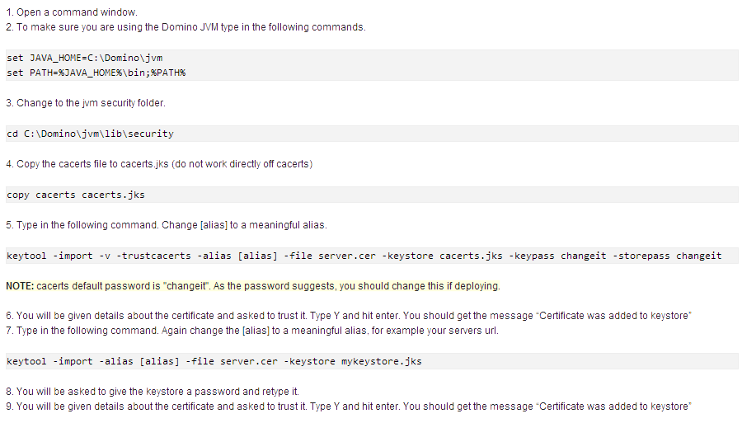
If your IdP Has a Self-Signed x.509 Certificate
Warning:
All these changes to the certificate keystore in the Domino jvm WILL get overwritten when you upgrade or re-install the server. Make sure to back them up!
You’re welcome.
-- Andrew
Source Article: “Connecting to a Domino server over SSL in Java, using a self signed certificate.” By Simon O'Dohert -- http://ibm.co/156IXwG

Slide 29
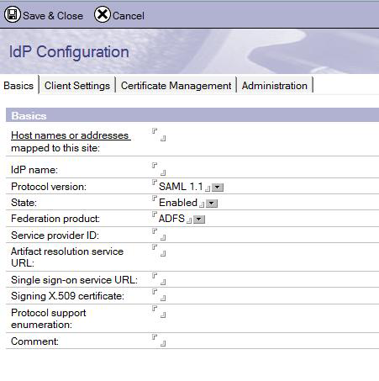
Now You’re Ready to Configure Domino!
Create “idpcat.nsf” from the “idpcat.ntf” template on your Domino 9 Server
Make sure to do it in lower case if you are on linux or unix, or if you ever in the figure might migrate to linux or unix (Just do it anyway)
In the “idpcat.nsf”create a new configuration document
Fill in the first four fields
Host Name MUST match a host name
on one of your WEB SITE documents. Use
an IP address if you plan to use SSL.
IdP Name is just a label for you – it can be
Anything you want.

Slide 30
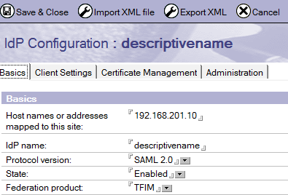
Configuring the idpcat.nsf Configuration Document
Click the “Import XML File” button to bring in the IdP metadata
WARNING: The file will be removed from the file system. No, there is no good reason for this. Make sure you have a backup even though it gets attached to the record.
The rest of the fields on this tab
will be filled in automatically

Slide 31
Check your Certificates
The certificates will be added automatically
Make sure they match the public key you were given
Make sure there are no carriage returns or line feeds in them
This will happen without anyone realizing it
If there are line feeds in this data, you will receive a meaningless error when you start the http task after configuring the system
HTTP Server: Error reading IdP configuration for server xxxxxx:Invalid arguments

Slide 32
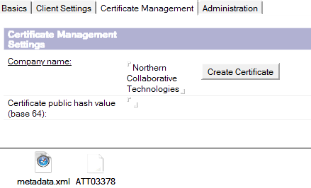
Continue Configuring the IDP Catalog Record
The “Client Settings” tab is used ONLY if you are going to use this SAML configuration for NOTES CLIENT logon.
This also requires configuration with the IDVAULT
On the “Certificate Management” tab fill in your company name
SAVE the document then Click
the “Create Certificate” button.
Click the “Export XML” button
To generate your “SP.XML” file
To give back to the IdP

Slide 33
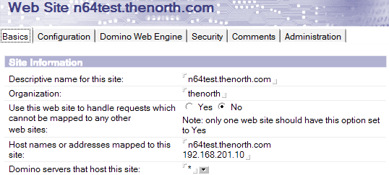
Now Configure The Website Document
You must be using the “Internet Sites” view
Setting is on the server document
You MUST say “NO” on
the third question and
Configure this site with
A host name to match.
While not required, you SHOULD specific an IP address in the “Host Names” field so that SSL can be used.
The values in the “Host Names” field will be used to find the correct IdP configuration in the “idpcat.nsf” file – make it match

Slide 34
Set Session Authentication to “SAML”
The “IdP Catalog” button will show up once you select SAML
If you have properly configured the IdP catalog record and the host name match this web site document, when you click that button, the IdP configuration record will open. If it does not, you have not matched the host names.
You can still use a multi-session LTPA Token in the “Web SSO
Configuration” field. If none is specified, single server session based authentication is used (just like without SAML)

Slide 35
Restart the HTTP Task
When you restart the HTTP task on the server, if your site is not properly configured it will give you an error.
The error will not be helpful. You probably have line feeds in your xml.
If all is configured, when you access a link on the domino server controlled by that website document which requires authentication, you will be redirected to the IdP to logon.

Slide 36
A few INI settings to help with debugging
SAML_NotOnOrAfterSkewInMinutes=[#]
Allows extra minutes in the 'not on or after' timestamp check on the SAML assertion.
SAML_NotBeforeSkewInMinutes=[#]
Allows extra minutes in the 'not before' timestamp check on the SAML assertion.
DEBUG_SAML=31
0x0001 (1) - Debug output contains information from http side.
0x0002 (2) - Debug output contains SAML parse information.
0x0004 (4) - Debug output only contains errors.
0x0008 (8) - Debug to dump decoded assertion.
0x0010 (16) - Debug to trace idpcat activity
0x0020 (32) - Trace replay prevention
0x0080 (128) - Dump the entire XML tree
0x0100 (256) - Dump canonicalized buffers
0x0200 (512) - Debug for the library sort
0x0800 (2048) - Debug for namespace use
0x2000 (8192) - Debug output for certificate management

Slide 37
Web Site Configuration Rules

Slide 38
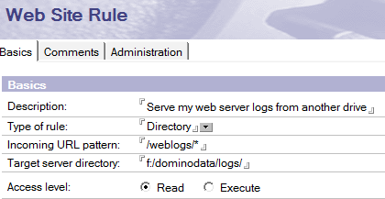
Directory Rules
This is used for content that is not in a database file
Allows you to serve content outside the domino/html/ directory

Slide 39
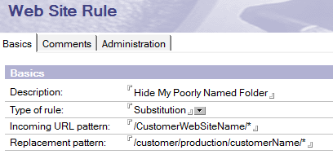
Substitution Rules
Substitutions leave the URL displayed in the browser alone
Allow you to hide folder or database file names
May also Useful if you’ve moved something but don’t want to break existing references & cached data

Slide 40
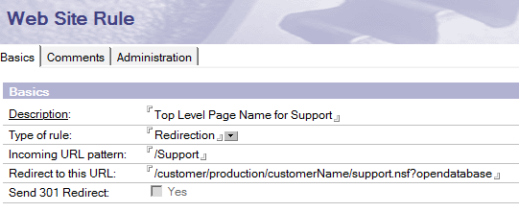
Redirection Rules
Unlike “Substitution” this tells the browser to make a new request for the page at a different location
A “301 Redirect” tells the browser that the change is permanent
The 301 Redirect option is only available if the target url includes the protocol (e.g. http or https)

Slide 41
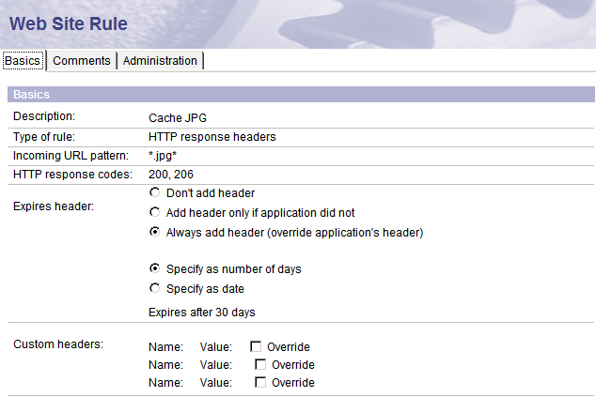
Response Header Rules
Adds a specific HTTP header to every page response that matches the URL pattern
Resources that don’t change frequently can be cached
JPG
PNG
GIF
MOV
MP3
MSI
MPG
ZIP
EXE

Slide 42
Override Session Authentication Rules
Some pages – particularly SOAP:XML based web services will not handle session based authentication well

Slide 43
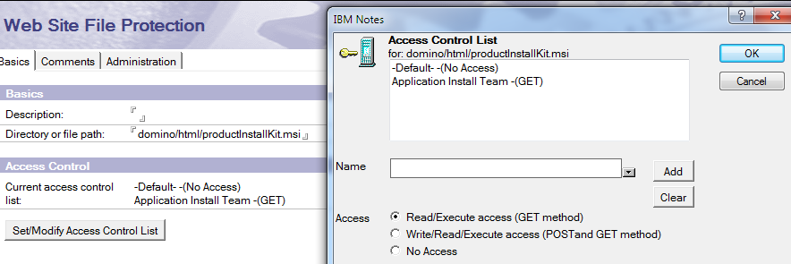
File Protection Rules
This allows you to set ACL security on files and directories that are not in Domino Databases

Slide 44
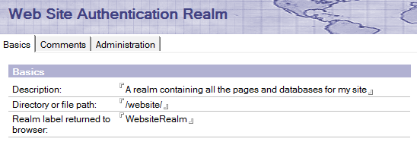
Authentication Realms
Important if you’re NOT using session based authentication
You should be using session based authentication!
This allows you to define the top level of the path that the browser will consider to be in the same authentication realm. The browser will use this to determine when to include your credentials with the request

Slide 45
SSL Certificate Configuration

Slide 46
Create A Cert Admin Database
The template is on your server
Click the advanced templates button

Slide 47
Open the Database
See the Nice Menu

Slide 48
Create A Key Ring
This file, and its sibling will be copied to your Domino server when you’re done. Use a good password – you won’t have to enter it when you restart Domino.
The entries in these fields are picky. Make sure to read the help line as you’re entering the information

Slide 49
Hooray! You have a keyring!

Slide 50
Back to the Menu
Now Create A Certificate Request

Slide 51
Creating A Certificate Request
Make sure to log the request, so you can get back to it if you need a new copy of the request key.
You almost always will be pasting this value into the CA’s website

Slide 52
Copy Your Certificate Request
You want the whole text from “Begin” to “End” including those lines
If you click ok and need to get this back, its in the log document

Slide 53
Here’s the Log Entry

Slide 54
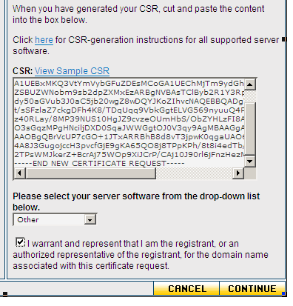
Now Go to the Certificate Authority
Each CA will have their own byzantine process by which you must submit the certificate request.
Most will need to verify you are who say you are.
This is a tricky step, and you have to deal with poorly designed CA web sites.
GoDaddy, Verisign, and InstantSSL are three of many CA’s to pick from.
* My current favorite is NAMECHEAP.COM
Warning! Many CA’s (like GoDaddy) are now issuing certificates signed with SHA2 by default – Domino will not accept these. You will get an unhelpful error message. You MUST use their menus to request the certificate in SHA1 format

Slide 55
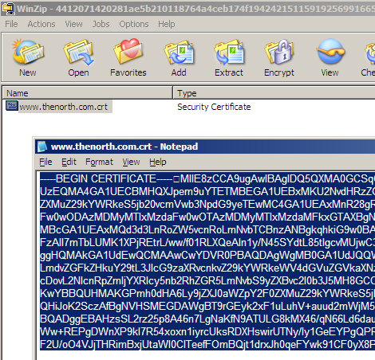
Get the Certificate From The CA
The CA will have a strange and painful process to give you the certificate.
In this case, when I finally got it, it is in a certificate file.
I just open that file in NOTEPAD and copy the text.
Most CA’s will let you just get the certificate as text.

Slide 56
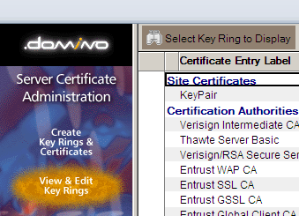
Back to the Database
You may have to select “View & Edit Key Rings” to open yours before you can proceed

Slide 57
Back To The Menu
Install Certificate Into Key Ring

Slide 58
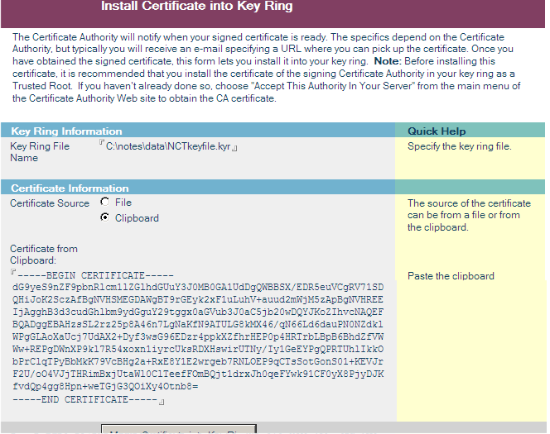
Install the Certificate

Slide 59
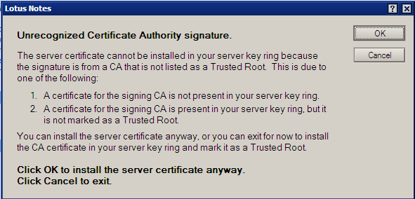
You May Need A “Trusted Root”
You’ll get this from your CA Provider
The Trusted Root is proof to that the actual certificate you have was issued by someone trustworthy even though they’re not the top level certifier.

Slide 60
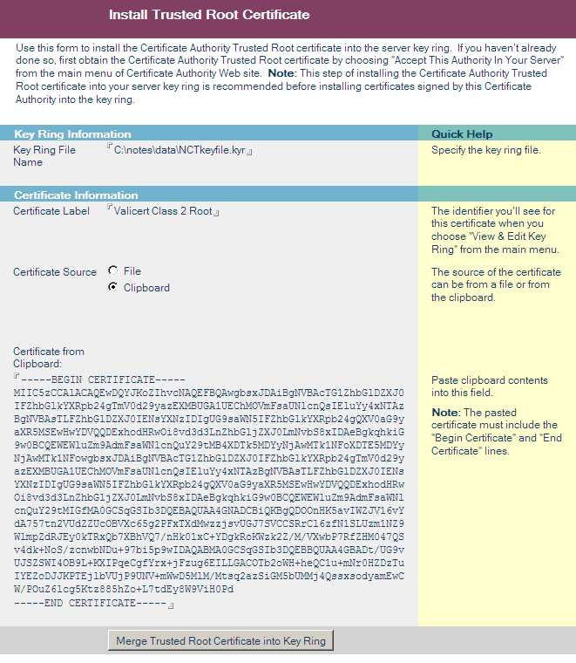
Install The Trusted Root Certificate
Back to the CA who will give you a lengthy set of instructions to download their trusted root certificate.

Slide 61
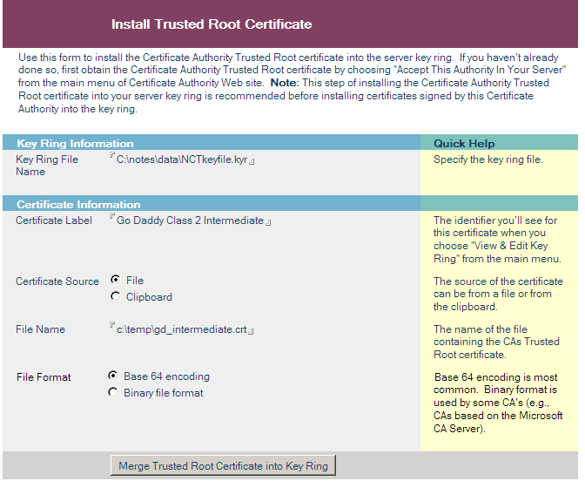
You Can Also Install From .CRT Files

Slide 62
Finally – You’re All Done
If you had to install trusted root certificates, you may not see this OK screen unless you re-install your actual certificate at the end.
It is ok to re-install your certificate if you want to be sure

Slide 63
What Do You Do Now?
Copy your .KYR file and another file with the same first name by the extension .STH which you’ll find in the same directory – over to your Domino Data directory
Remember, in Linux, to set its Owner and Group to ‘notes’ and its permissions to 644 so that the server can read it properly

Slide 64
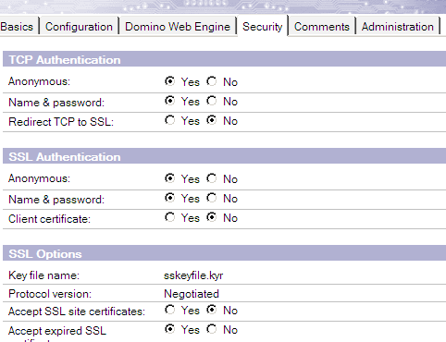
And Finally…
Reference the .KYR file (Key Ring) in your Internet Sites document for the HTTP site you’re setting up!
You have to restart the http task for this to take effect.

Slide 65
Domino & SHA-2 Encrypted Certificates
All these details are true as of Domino 9.0.1 but may have changed if you have downloaded this presentation
SHA-2 SSL Certificates are still not supported by Domino
IBM Have acknowledged the problem but not yet promised a date for resolution
Only workaround for now is a reverse proxy or an alternate http stack
IBM IHS can be used with Domino 9+ on Windows
You could use the Microsoft IIS Server Stack
According to Bruce Schneier the cost of renting sufficient processing to brute force SHA-1 will be $43k by 2021 http://bit.ly/1DCClt6
Beginning this fall Google Chrome will start indicating lower safety levels in the browser for sites with SHA-1 based certificates

Slide 66
Beginning This Fall Chrome Flags SHA-1
Reference: http://bit.ly/1DCIMfO
Starting September 2014
Sites with SHA-1 Leaf Certs expiring after Jan 1st 2017 will show “Secure with minor errors”
Starting November 2014
Sites with SHA-1 Leaf Certs expiring between June and December 2016 will show as “Secure with minor errors”
Sites with SHA-1 Leaf Certs expiring after Jan 1st 2017 will show “neutral – lacking security”
Starting Q1 2015 (Chrome 41 Release Time)
Sites with SHA-1 Leaf Certs expiring between June and December 2016 will show as “Secure with minor errors”
Sites with SHA-1 Leaf Certs expiring after Jan 1st 2017 will show “affirmatively insecure”

Slide 67
Using a Reverse Proxy
Reverse proxies can be used to support SHA-2 and TLS
Apache Reverse Proxy
Free and Open Source
http://www.apachetutor.org/admin/reverseproxies
The IHS (IBM HTTP SERVER) Module
Windows Only
Domino 9.0+
Part of the Domino Installation Kit
Installation and configuration requires several steps
Good resource by Yvonne Devlin, IBM Software Engineer
http://ibm.co/1t23HAK

Slide 68
Memory & Performance Tuning

Slide 69
Performance Tuning
Before you start making changes to the way memory and threads are configured, make sure you’ve already looked at the general server and network performance issues
Make sure the server is well configured for the task
Make sure the network is sized for the content
Suggested Session: Domino Performance In the Real World
Admincamp 2014 - Wednesday at 11:00 (or from my website)

Slide 70
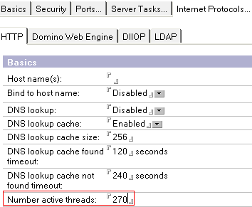
Deciding How Many Threads to Allocate
Thread pooling means waiting for page loads
Like a line for checkout at the grocery store
Up to 40k Per Thread
Can be an issue – especially on 32 bit servers
Show Statistics to determine need
Domino.threads.active.peak
http.currentconnections
http.peakconnection

Slide 71
Domino HTTP Threads
One web page may require several threads
One thread per HTTP/HTTPS Request
Including every image, script, and style sheet
Any agent uses a thread of it’s own
Including WQO and WQS agents
Traveler uses 1 thread per device
Domino default is 40 threads
Traveler will change this using an INI parameter
NTS_MAX_HTTP_THREADS
32 bit Traveler Server: 100
64 bit Traveler Server: 400

Slide 72
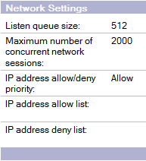
Server Wide Settings
Listen Queue Size
This is all the sessions waiting for an active thread
Setting it higher will probably hurt, not help
The operating system also limits the queue size
Maximum Number of concurrent sessions
Very little documentation available
Should be at least as high as the number of threads
Probably best to leave it alone
Persistent Connections
Disable on most server after version 5
It is now faster to re-establish the session than hold it open

Slide 73
Domino Thread Pooling Methods
Configured in the NOTES.INI
HTTPQueueMethod = 0
Default Prior to 8.5.1
Simple Round Robin – You get in the next line regardless of how many are in it already
If you get in the wrong line, you wait, even if another line is open
HTTPQueueMethod = 1
Optimized Line Assignments – You get put in the shortest line at the time you arrive
If your line takes a long time, you’re stuck in it
HTTPQueueMethod = 2
Default For 8.5.1+
There is only one line, each request gets the next available thread

Slide 74
Tuning HTTP Memory Usage
HTTPUseNotesMemory & iNotesUseNotesMemory
Setting to 0 will use the OS memory management routines
Better memory utilization & performance (slight)
Less debugging information available
HTTPJVMMaxHeapSize
Introduced in 8.5 to govern the memory used by the HTTP JVM
JavaMaxHeapSize is similar but applies to all JVM processes
The default value in 8.5 is 256Mb
The default value in 8.5.2 is 64Mb
On IBM iSeries 256Mb is required
On 64 bit machines with plenty of memory you can set much higher
JavaStackSize
Default is 409600 (400kb)
You only need to increase this if your has deeply nested function calls and recursive algorithms.

Slide 75
Other Important Files

Slide 76
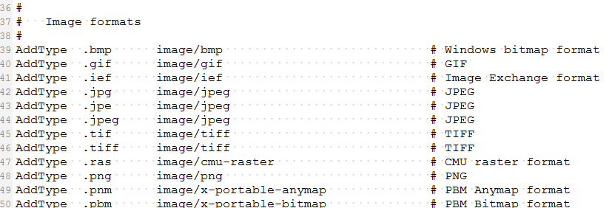
HTTPD.CNF
MIME type configuration
If you make changes mark the file read-only and back it up
This file will be over-written during server upgrades

Slide 77
BROWSER.CNF
Tells DOMINO what kind of output it can generate based on the “User-Agent” header in the request
You probably don’t want to change this
If you make changes mark the file read-only and back it up
This file will be over-written during server upgrades

Slide 78
Clustering and Failover
Do Not Cluster Traveler
Unless you fully configure Traveler High Availability
Traveler High Availability is another presentation
Clustering HTTP with ICM
Web Site Host Name points to the server running ICM
ICM Probes and monitors configured cluster servers
ICM is included in your Domino Licensing
Third party load balancers
BIG IP
IBM Edge Load Balancer
Apache Reverse Proxy

Slide 79
A few Security Tips
See Also:
“Performing Your Own Domino Security Review” presentation on my website

Slide 80
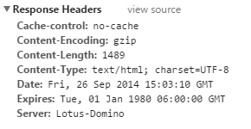
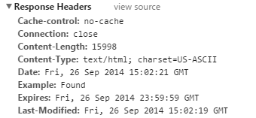
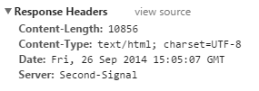
Rule 1: Don’t Advertise Your Server Type
HttpDisableServerHeader=0 (Default)
HttpDisableServerHeader=1
Once you disable the default You can use an HTTP Response Header rule to use any value you want for the server

Slide 81
Threat Types
Even paranoid people have enemies

Slide 82
Developer Mistakes
Stability is part of Security
Java & XPages Especially
Failure to Recycle
Long Running Agents
Code in Agents That Eats Resources
Searching Unindexed Databases
Massive Document Updates

Slide 83
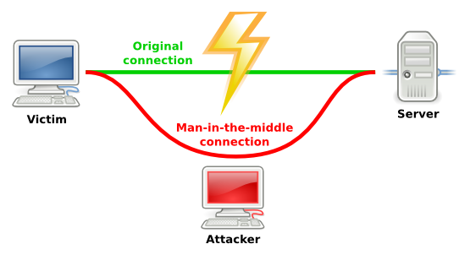
Man in the Middle Attacks
Your best defense is enforced use of SSL
Do not run Traveler servers without forcing SSL

Slide 84
Cross Site Scripting Attacks
Traditionally this ignored by Domino developers because Notes documents are not SQL based and most of the escape sequences are handled by the server
HOWEVER
With more and more web development using hand crafted AJAX calls and parameters passed to agents and forms, Domino becomes vulnerable as well.
You have to do a security review of your custom code

Slide 85
Buffer Overflows & other exploits
Contrary to popular belief – Domino is definitely vulnerable to these just like any other server
Best defense is to keep as current as possible with server patches and upgrades
Keep any ports you aren’t using disabled
Block any unnecessary network traffic at the firewall
High end firewalls can do deep “Packet Inspection” to help block exploits before they hit the server

Slide 86
Site Browsing Attacks
Use the CATALOG.NSF and configure DDM to warn you of any databases with DEFAULT access that would allow use you have not tested thoroughly
Developers like to “HIDE” things and think that means they are secure.
Exposed view names can lead to direct access to the view
Exposed document UNIDs can lead to direct URL commands
Never Trust Form Input or Agent Parameters!
My favorite Domino Database Hack was one a user at AdminCamp showed me a few years ago that used a SQL injection methodology but used formula language instead of SQL as part of a search parameter

Slide 87
Poor HTTP Password Controls
Tie your http passwords to the Notes userid passwords
Enforce password standards!
If you want to let users use Notes.ID passwords that are weak, that your business – at least it’s primarily internal users
Scripted tools are almost constantly trying commonly used passwords against your server
This includes not just your HTTP ports – SMTP is an even more common target because the logs aren’t reviewed as frequently and the payoff is that you get turned into a spam relay server
Adding “1” or “1234” to a dictionary word is not helpful
Changing “e” to “3” and “l” to “!” is also not helpful

Slide 88
Tips for Debugging HTTP

Slide 89
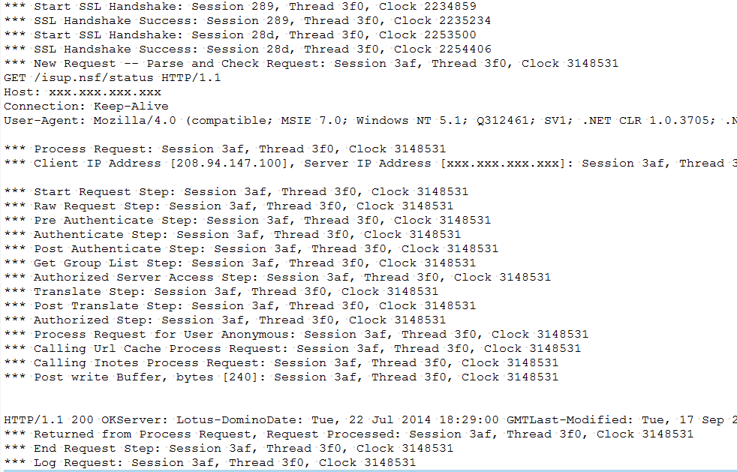
Enable HTTP Request Logging
Console Command: Tell HTTP debug thread on
Remains in effect until the task is restarted or you issue the same command with “off”
If you want it to remain in effect longer use the INI setting “HTTPEnableThreadDebug=1”
This will write very detailed logging of each HTTP session
Files will be stored in the “IBM_TECHNICAL_SUPPORT” folder
These files will fill your drive if you leave this setting on!

Slide 90
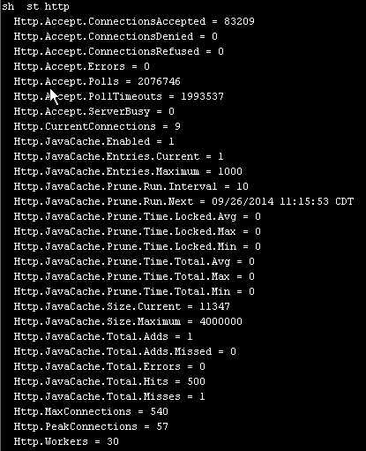
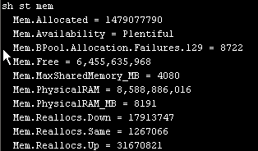
Review Statistics
Show st mem
Show st http

Slide 91
Collect Heap Dump Data
For XPages
tell http xsp heapdump (Domino 8.5.1+)
For Agents & Pages
tell http dump java heap
tell http dump java core
tell http dump java system
tell http dump java *

Slide 92
Questions?
Ask now, don’t wait for the end and ask quietly at the podium
The most up to date copy of this presentation will be on my blog site: http://www.thenorth.com/apblog
Andrew Pollack – Northern Collaborative Technologies
andrewp@thenorth.com
http://www.TheNorth.com
92

